Slide 1
Sequence - Reservation
Now let’s have a look to an example of runtime behaviour of the system.
The context chosen is a successfull taxi reservation, which is a quite relevant case and involves almost all the components.

Slide 2
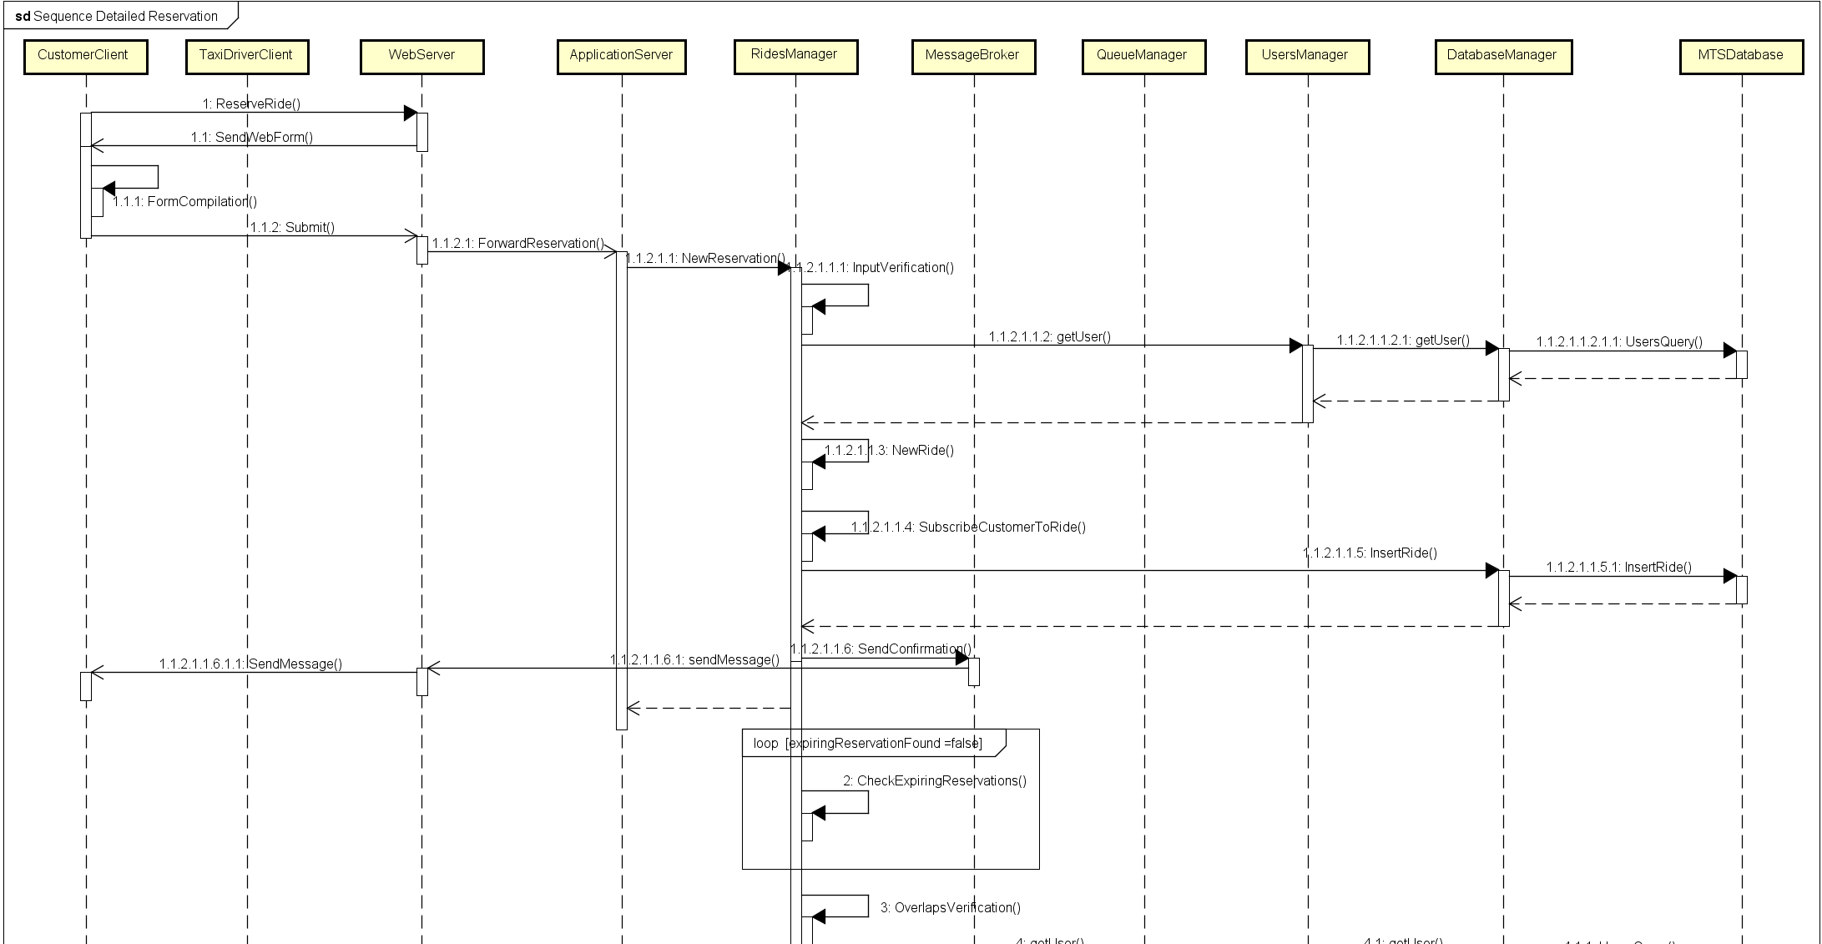
Sequence - Reservation

Slide 3
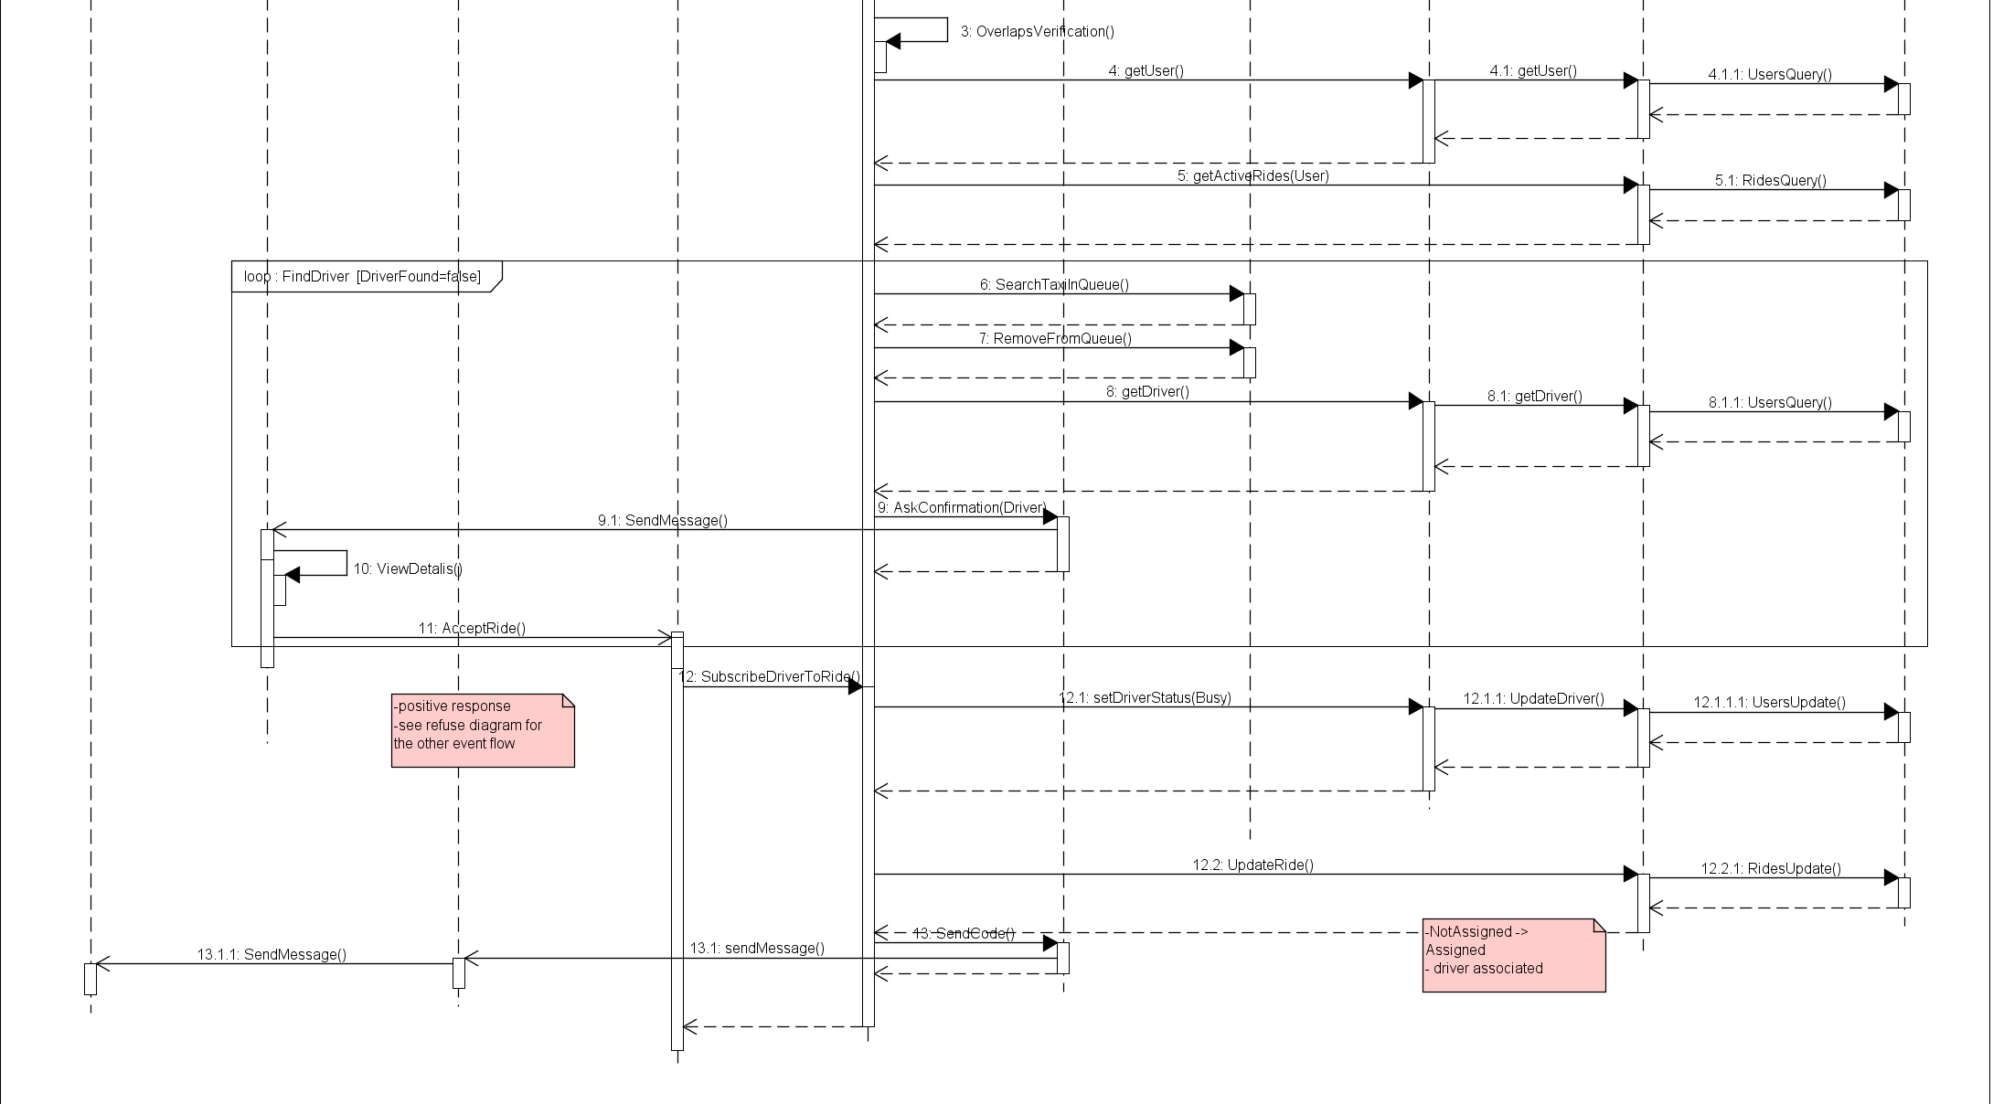
Sequence - Reservation

